Slide 1
Heads Up
Midterm: Oct 29 (10/29), 10:10 ~ 12:00
Close Book
Coverage: L1 ~ L3 (without advanced topics)
Split folks into several rooms (EC122, ED102, …), will announce the seat table this week.
Announce our 2nd hands-on later today.

Slide 2
Q & A
IOMMU can greatly reduce the need for ZONE_DMA. However, Linux maintains these memory zones to ensure broad hardware support and backward compatibility.

Slide 3
Recall: Basic Concepts of Memory Management
Page Frame: Partition physical address space to chunks with the same size
Page (Virtual): Partition virtual address space to chunks with the same size
Physical vs Virtual Addresses
Physical: The location where the data actually stored on the device. (Page Frame)
Virtual: The location where the programmers think the data is. (Page)

Slide 4
Recall: Manage Physical Address (Page Frame)
Although the processor’s smallest addressable unit is a byte, the memory management unit (MMU) typically deals in pages (e.g., 4KB or 8KB).
Each page frame is managed by a struct page structure (struct page is associated with physical pages, not virtual pages)
Overhead: 40B for each struct page, 4KB for each page frame, 4GB DRAM Require Only 40MB
struct page {
unsigned long flags;
atomic_t _count;
atomic_t _mapcount;
unsigned long private;
struct address_space *mapping;
pgoff_t index;
struct list_head lru;
Void *virtual;
};
→ status, e.g., dirty, lock
→ How many references.
→ If the page is used by page cache
→ Offset of a file or a swap file.
→ For the page replacement policy
→ Page’s virtual address

Slide 5
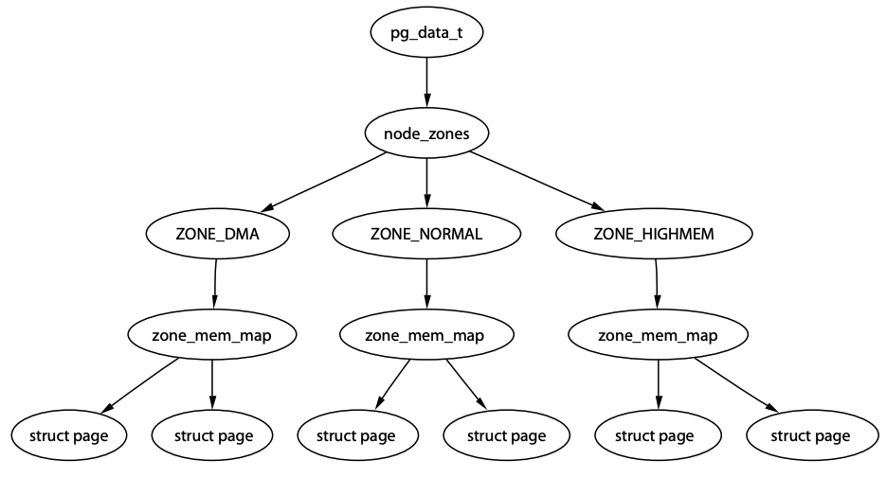
Recall: Manage Kernel Physical Address (Nodes)
Uniform Memory Access vs Non-Uniform Memory Access
Nodes
Maintains a data structure (pg_data_t) for each NUMA node.
Allocate memory from the node closest to the running CPU.
Granularity: Nodes → Zones → Page Frames
CPU
CPU
Local Access
Remote Access (~2x Slower)
Why NUMA?
Fast local access
Higher bandwidth
Easy to scale out
Memory
Controller
CPU
CPU
DRAM
Memory
Controller
Memory
Controller
DRAM
DRAM
DRAM
A memory node (or bank)
Ref: Gorman, Mel. Understanding the Linux virtual memory manager. Upper Saddle River: Prentice Hall, 2004

Slide 6
Recall: Linux Page Allocation
alloc_pages() function allocates a single page or 2^{order} pages and returns pointer to the first page’s page struct. (Buddy System)
For more general byte-sized allocations, the kernel provides kmalloc().
User-space Memory Allocation
Kernel-space Memory Allocation
Big Size
Small Size
malloc() – C Library
vmalloc()
kmalloc()
Request Size
(Large for MMap)
Brk()
Mmap()
Slab Layer
If no slabs
Low-level Memory Allocator
(alloc_pages() – Buddy System)
Page Granularity
Physical DRAM
Ref: Advanced Operating Systems, Shinpei Kato, 2018 https://www.pf.is.s.u-tokyo.ac.jp/wp-content/uploads/2018/10/AdvancedOperatingSystems3.pdf

Slide 7
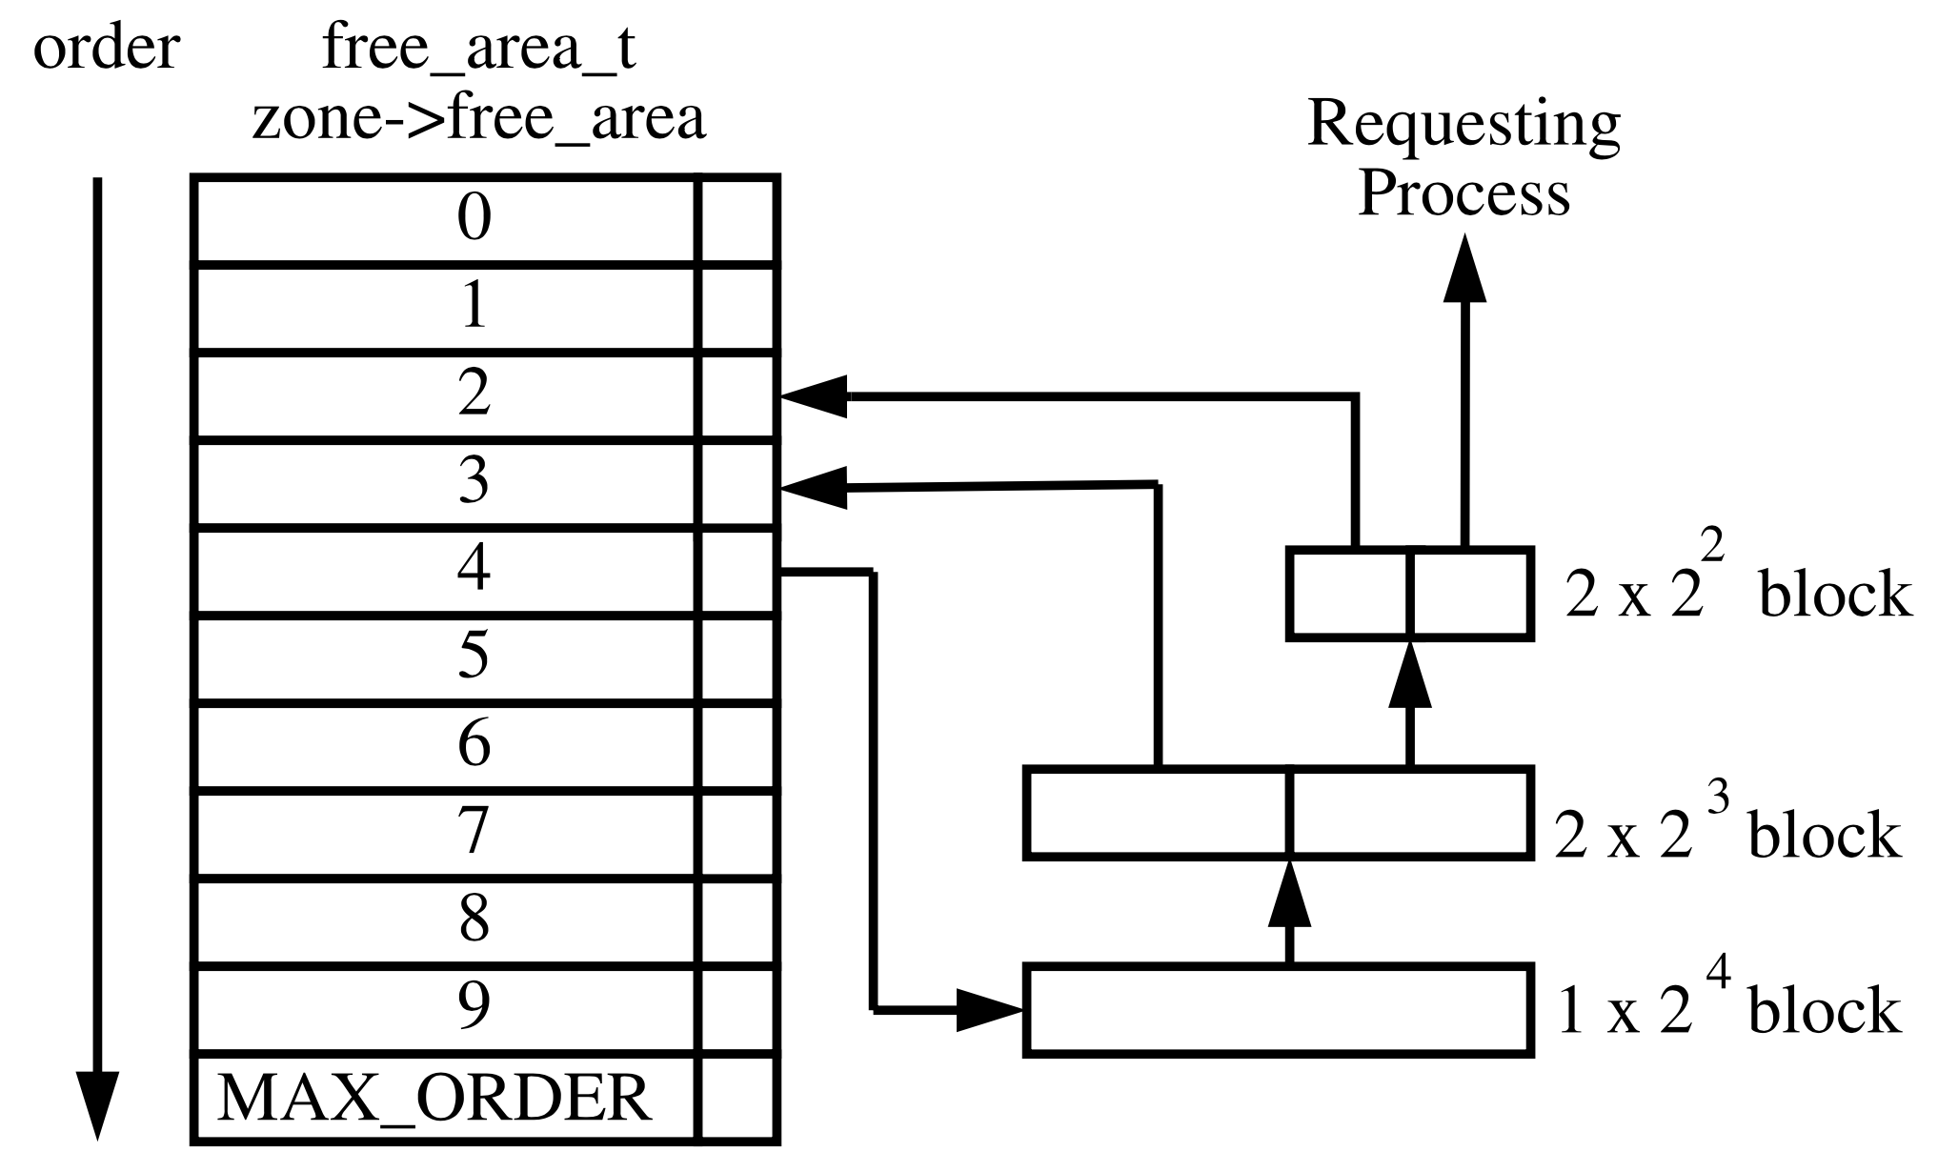
Recall: Linux Page Allocation -- Buddy System
alloc_pages function allocates a single page or 2^{order} contiguous physical pages and returns pointer to the first page’s page struct. (Buddy System)
If a process requests a 2² block. But there is no free pages in order 2 and 3.
Ref: Gorman, Mel. Understanding the Linux virtual memory manager. Upper Saddle River: Prentice Hall, 2004

Slide 8
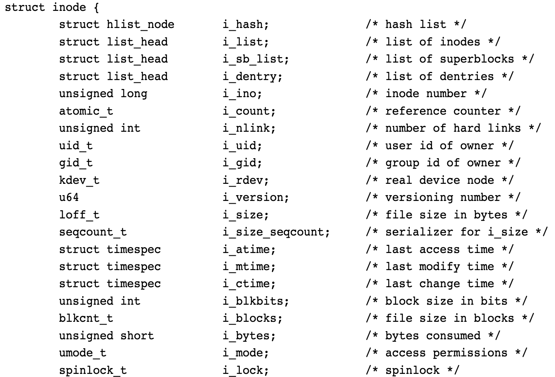
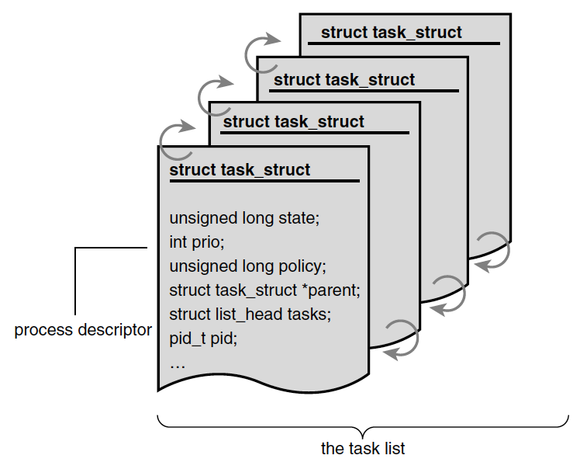
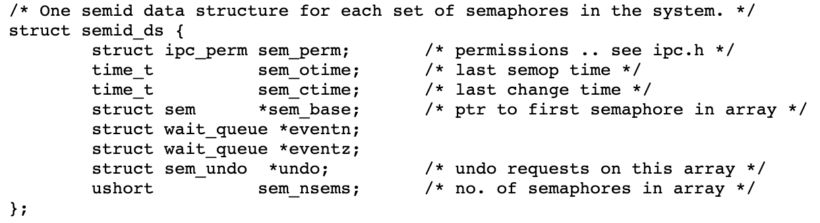
Recall: Why Slab Layer?
Grouping kernel objects (i.e., data structure) into slab caches. Pre-allocating memory pages in slabs leading to faster memory allocation.
When the data structure is no longer needed, it is returned to the free list instead of deallocated.
Example: process descriptors (a free list of task_struct), file objects (inode), semaphore

Slide 9
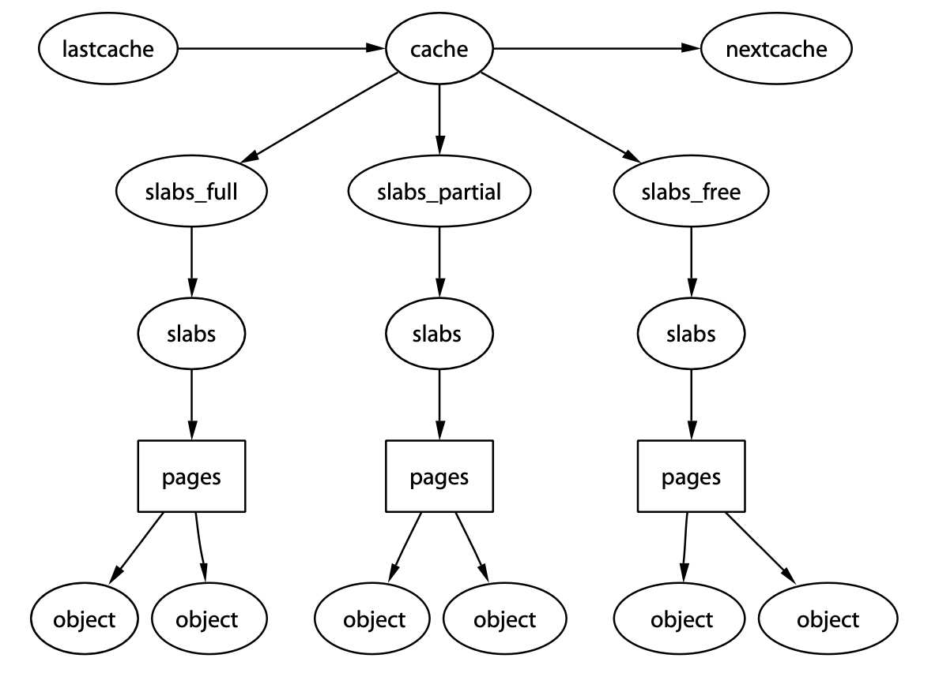
Recall: How Slab Layer Works
One cache per object (e.g., task_struct, inode, semaphore) type
Main Idea: Avoid from allocating and freeing physical address as frequent as possible.
Structure: Cache → Slab → Page
Full Lists
Partial Lists
Empty Lists
Contiguous Memory
Slab 1
Slab 2
Slab 3
Page
Page
Page
Used
task_struct
Unused
task_struct
Unused
task_struct
Used
task_struct
Unused
task_struct
Unused
task_struct
Page
Page
Page
Used
task_struct
Used
task_struct
Unused
task_struct
Used
task_struct
Used
task_struct
Unused
task_struct
On Full Lists
On Partial Lists
On Empty Lists
Ref: Gorman, Mel. Understanding the Linux virtual memory manager. Upper Saddle River: Prentice Hall, 2004
Notes:
The slab layer divides different objects into groups called caches, each of which stores a different type of object.
Full Lists: All objects on a slab marked as used
Partial Lists: Slab comprises both used and free objects
Empty Lists: All objects on a slab marked as free

Slide 10
Process Address Space (Virtual Address)
Notes:
Good Morning, My name is Chun-Feng Wu. In this presentation, I will briefly introduce myself and share some key idea of my researches.
Intensive data movement is one of the critical issue when Von-Neumann machines enter the big data era.
To deal with this issue, my research is to enable a fast, large and device-friendly next-generation computing system.

Slide 11
Virtual Address Spaces
On Linux, each process is given a unique and flat 32- or 64-bit address space.
Unique: Processes can have different data at the same address in their own address space. (Note: Processes can also share address space, like threads)
Flat: Modern Linux system does not use segmentation.
Memory address is a particular value identifying a specific byte in a process’s address space (32-bit address space: 2³² B)
Temporary Mapped
Kernel Virtual
Address Space (1G)
Kernel Code/Data
Process-Specific Data Structures (e.g., Page Table, kernel stack, mm_struct)
User Stack
Memory-Mapping for Shared Library
User Virtual
Address Space (3G)
//This is a C code
#include <stdio.h>
int global_x;
int global_y=10;
main(){ int local_x;
int *local_y;
p=(int*)malloc(20);}
Heap (via malloc())
BSS Section
(Uninitialized Global Variable)
Data Section
(Initialize Global Variable)
Text Section (e.g., Code)
Ref: Gorman, Mel. Understanding the Linux virtual memory manager. Upper Saddle River: Prentice Hall, 2004
Per Process Virtual Address Space On 32-bit System
User Mode

Slide 12
Virtual Address Spaces
On Linux, each process is given a unique and flat 32- or 64-bit address space.
Unique: Processes can have different data at the same address in their own address space. (Note: Processes can also share address space, like threads)
Flat: Modern Linux system does not use segmentation.
Memory address is a particular value identifying a specific byte in a process’s address space (32-bit address space: 2³²)
Not every address is legal, intervals of legal addresses are memory areas.
Permission: readable, writeable, executable
Temporary Mapped
Kernel Virtual
Address Space (1G)
Kernel Code/Data
Process-Specific Data Structures (e.g., Page Table, kernel stack, mm_struct)
User Stack
Memory-Mapping for Shared Library
User Virtual
Address Space (3G)
Heap (via malloc())
BSS Section
(Uninitialized Global Variable)
Data Section
(Initialize Global Variable)
Text Section (e.g., Code)
Ref: Gorman, Mel. Understanding the Linux virtual memory manager. Upper Saddle River: Prentice Hall, 2004
Per Process Virtual Address Space On 32-bit System
User Mode

Slide 13
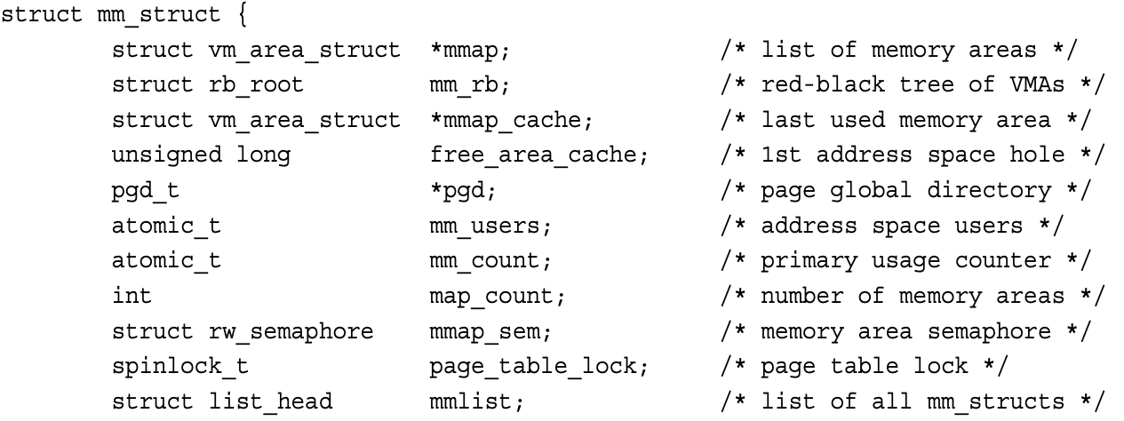
The Memory Descriptor
Memory descriptor (struct mm_struct) is a kernel data structure contains all information related to the process’s address space.
The memory descriptor associated with a given task is stored in the mm field of the task’s process descriptor.
Different data structures with the same content:
all the memory areas in this address space.
Linked List → Fast for traversing, RB Tree → Fast for searching
Notes:
The key difference between the two is that mm_count tracks references to the memory map, which can come from multiple processes, threads, or sources, while mm_users specifically counts the number of users within the same process that are sharing the memory map. In many cases, mm_users will be equal to or less than mm_count because it's focused on the per-process reference count.

Slide 14
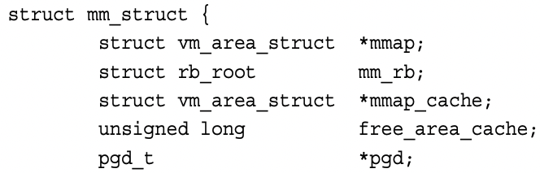
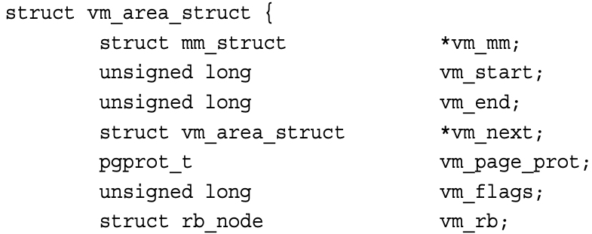
Virtual Memory Areas (VMA)
The memory area (or VMA) structure (vm_area_struct) describes a single memory area over a contiguous interval in a given virtual address space.
page
Process’s Virtual Address Space
VMA
VMA
VMA
vm_start
vm_end
vm_next
vm_next
vm_area_struct
mmap
mm_struct (Memory Descriptor)
Ref: https://manybutfinite.com/post/how-the-kernel-manages-your-memory/

Slide 15
Virtual Memory Areas (VMA) (Count.)
The memory area (or VMA) structure (vm_area_struct) describes a single memory area over a contiguous interval in a given virtual address space.
vm_area_struct
VM_READ | VM_WRITE | VM_GROWS_DOWN
Maintains a vm_area_struct for each file
struct file
/lib/libc.so
vm_area_struct
VM_READ | VM_EXEC
User Stack (Anonymous)
Chaining if heap is not contiguous
vm_area_struct
VM_READ | VM_WRITE
Memory-Mapping for Shared Library
Process’s Virtual Address Space
vm_area_struct
VM_READ | VM_WRITE
vm_start
vm_end
Heap (Anonymous)
vm_next
vm_next
vm_file
BSS Section
(Anonymous)
No File-Backed
vm_area_struct
VM_READ | VM_WRITE
vm_area_struct
struct file
/bin/execute
vm_next
Data Section
(File-backed)
mmap
vm_area_struct
VM_READ | VM_EXEC
vm_end
Text Section (e.g., Code)
vm_file
vm_start
mm_struct (Memory Descriptor)
mmap
task_struct
mm
mm_struct
Process’s Virtual Address Space
Ref: https://manybutfinite.com/post/how-the-kernel-manages-your-memory/

Slide 16
Virtual Memory Areas (VMA) (Count.)
The memory area (or VMA) structure (vm_area_struct) describes a single memory area over a contiguous interval in a given virtual address space.
Any two VMAs cannot overlap with each other. (Could call the find_VMA() to get the nearby VMAs. Checking the vm_end field.)
Merge two VMAs if they overlap with each others.
How to create or expand a VMA: do_mmap() is the function used to add an address interval to a process’s address space—whether that means expanding an existing memory area or creating a new one.
No file & offset → Anonymous
Initial Address for Finding Available Space
unsigned long do_mmap(struct file *file, unsigned long addr, unsigned long len, unsigned long prot, unsigned long flag, unsigned long offset)
Permission
File Offset

Slide 17
Recall: Basic Concepts of Memory Management
Page Frame: Partition physical address space to chunks with the same size
Page (Virtual): Partition virtual address space to chunks with the same size
Kernel manages all page frames and maintains page tables.
Virtual Memory Management: Let all processes share the same physical address space via page tables. (Each process thinks they own the whole space.)
CPU
VA
Not in TLB
TLB
MMU
VA’ -> PA’
1
PA
2
Page
Table
Page Frame
Page Frame
Page Frame
Page Frame
Page Frame
Page Frame
Page Frame
Page Frame
Page Frame
Page Frame
Page
Data
……
……
VA -> PA
Assume only one-level (4-level Actually)
4KB
Physical Address Space (e.g., DRAM)

Slide 18
Page Tables
For systems with virtual memory management (or MMU), all virtual addresses shall be converted to physical addresses before being accessed.
Page Tables take the responsibility for address translations.
Each page table comprises a bunch of 8B page table entries (PTE) on 64-bit systems.
Size of page table is proportional to the memory size. (Larger Memory, More PTEs)
Linux uses multi-level page tables. (4-level for 64-bit systems)
Without optimization, CPU shall access memory for looking up a page table each time.
TLB is a hardware cache to keep the mapping between the VA/PA in the CPU.
CPU raises a page fault when a process accesses a memory page without proper preparations.
Minor Page Fault: Page is already in the memory but is not marked in the MMU as being loaded in memory. (e.g., malloc() allocates physical addresses once being touched)
Major Page Fault: Page is not in the memory. (May cause expensive I/O movement costs)

Slide 19
How the CPU Walks Page Tables
Let’s take 64-bit systems as an example. (Actually, only use 48bits)
The base address of PGD is maintained in CPU’s CR3 register.
CPU can walk automatically. Or kernel code can also walk it.
64bits Victim Virtual Address
+
pgd_offset()
+
pud_offset()
+
pmd_offset()
+
pte_offset()
64bit
Reserved
64bit
48bit
39bit
30bit
21bit
12bit
0bit
Unused Bits
(16bits)
PGD Offset
(9bits)
PUD Offset
(9bits)
PMD Offset
(9bits)
Page Table Offset (9bits)
Page Offset (12bits)
48bit
Physical
Address
Page Global Directory
(PGD) Table
Page Upper Directory
(PUD) Table
Page Middle Directory
(PMD) Table
Page Table (PT)
P
3
P
P
P
PGD Entry
+
PUD Entry
4
PMD Entry
PT Entry
12bit
+
PMD Entry
…
Control Bits (e.g., Present bit)
…
…
5
2
…
+
PT Entry
1
PGD Base Address
+
PGD Entry
PUD Entry
PMD Entry
…
PGD Entry
PUD Entry
PMD Entry
PT Entry
0bit

Slide 20
Why 4-Level Page Tables for 64-bit System
4KB Page
P
P
Last Level 2³⁶ Pages
Page Size = 4KB (2¹²B)
Virtual Address Space Size = 2⁴⁸ B (48-bit virtual address)
Page Table Entry Size is 8B
How many levels:
Last-Level: (2⁴⁸/2¹²)*8 = 2³⁹ B ( > 2¹²B)
Last 2 Level: (2³⁹/2¹²)*8 = 2³⁰ B ( > 2¹²B)
Last 3 Level: (2³⁰/2¹²)*8 = 2²¹ B ( > 2¹²B)
Last 4 Level: (2²¹/2¹²)*8 = 2¹² B ( <= 2¹²B)
……
4KB Page
……
4KB Page
Can’t fit in one page (or one page table)
Last level
2³⁹ B PTE
……
……
PTE
PTE
PTE
4KB PT
……
4KB PT
Last 2 level
2²⁷ Page Table
Can’t fit in one page (or one page table)
Last 2 level
2³⁰ B PTE
……
P
PTE
PTE
4KB PT
4KB PT
Last 3 level
2¹⁸ Page Table
……
Can’t fit in one page (or one page table)
Last 3 level
2²¹ B PTE
……
P
PTE
PTE
4KB PT
4KB PT
Last 4 level
2⁹ Page Table
……
Fit in one page (or one page table)
Last 4 level
2¹² B PTE (One Page Table)
……
P
PTE
PTE
Ref: https://www.geeksforgeeks.org/multilevel-paging-in-operating-system/
Notes:
Memory is byte addressable, so one bit can address one byte

Slide 21
Advance Topics for Memory Management
Notes:
Good Morning, My name is Chun-Feng Wu. In this presentation, I will briefly introduce myself and share some key idea of my researches.
Intensive data movement is one of the critical issue when Von-Neumann machines enter the big data era.
To deal with this issue, my research is to enable a fast, large and device-friendly next-generation computing system.

Slide 22
How to enable MMU
The MMU is inactive while systems boot.
The MMU is active until CPU runs the MMU-enabled command (by setting CP15). After running it, each memory address shall be transferred by MMU.
How to run a user process right after enabling the MMU:
CPU runs a jump command to execute the virtual address, which points to the start of the next process.
Enable MMU
CPU
MMU Enabled Command
CP15 → The 15th coprocessor is reserved for managing MMU.
Virtual Address
0x40
0x44
0x100
0x40
ST, CP15, 1
MMU
0x44
JMP,
0x100
0x84
0x84
Next Proc
Cache
Physical Address Space
Abstract of CPU

Slide 23
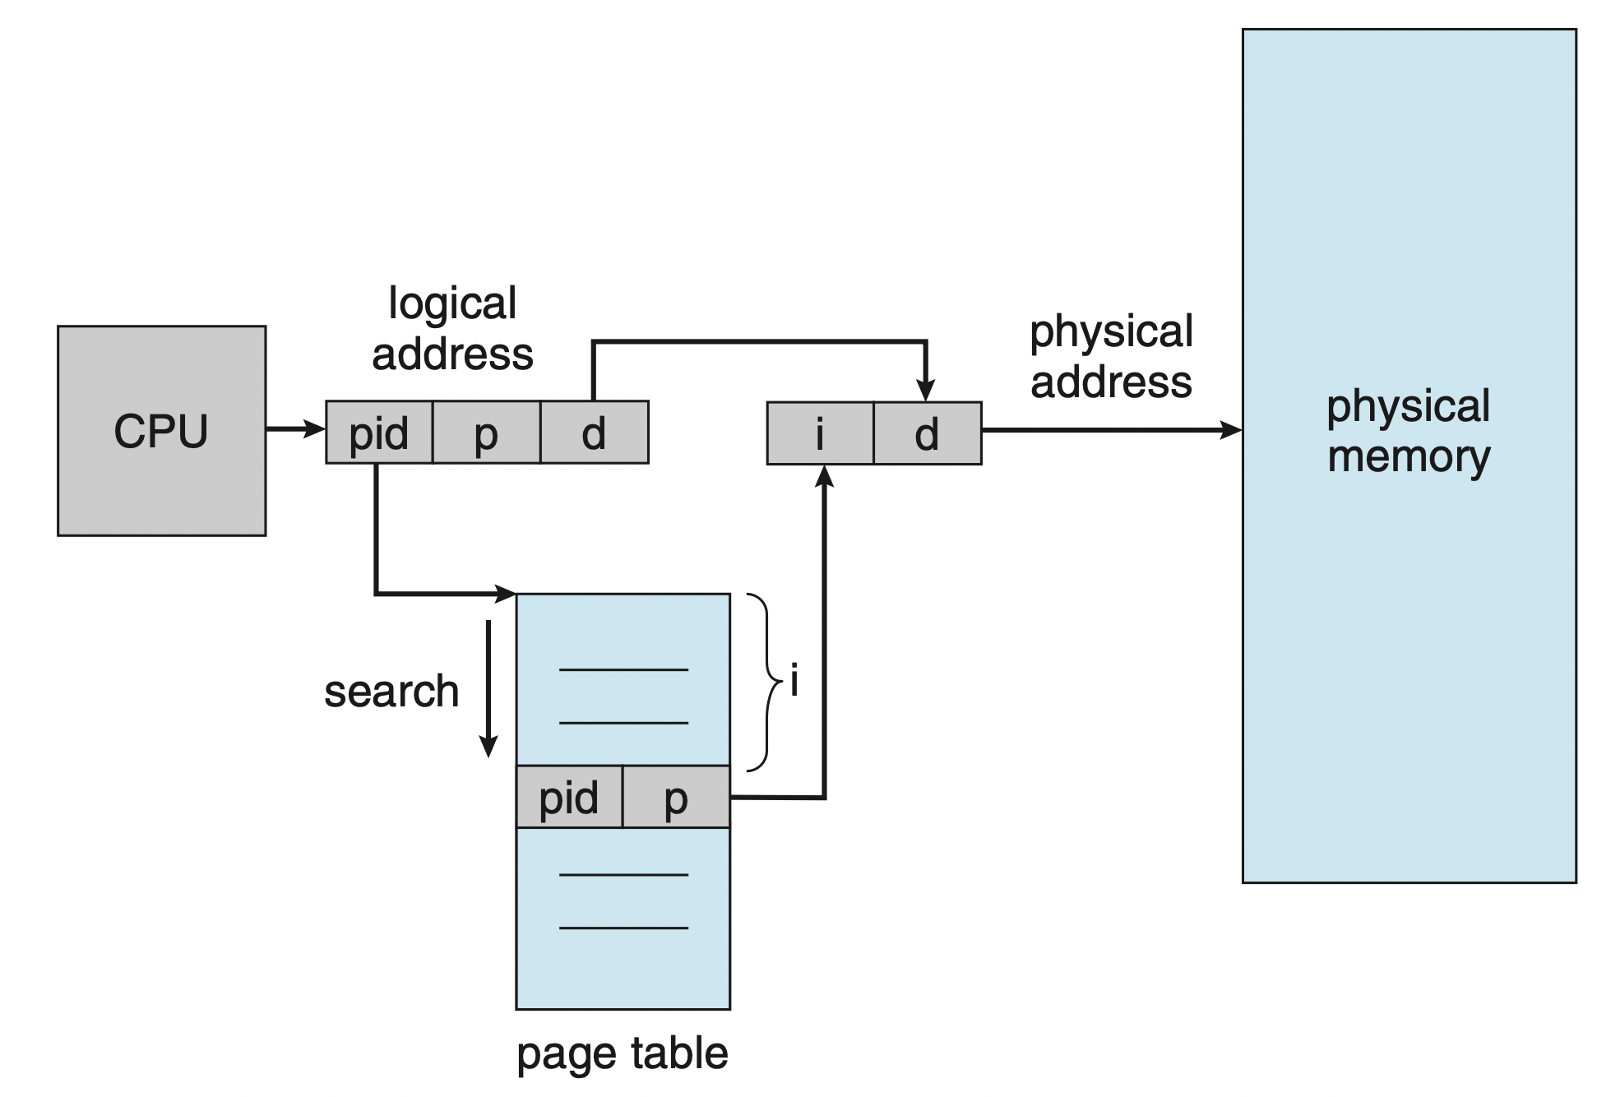
Out-dated: Inverted Page Table
Issue 1:Systems consume large memory space to store multi-level page tables.
Idea: Single-level page table, PTE = <process-id, page-number, offset>.
<process-id, page-number> equals to the function of multi-level tables.
If a match is found, <process-id, page-number> = i, get physical page (frame) by <I, offset>. (Sorted by the physical addresses)
Disadvantages:
Shall walk through the whole table if there is no matched.
One physical page cannot have two shared virtual addresses.
Ref: Operating System Concepts (Tenth Edition)

Slide 24
Huge Page Management
CPU
MMU
Regular TLB (4KB)
Huge TLB (2MB)
VA 0
PA 3
VA10-522
PA 80-592
Challenge of using 4KB page size.
TLB_Reach (TLB_Size X Page_Size): The amount of memory accessible from the TLB. (High TLB Misses)
Page Table Walk: Up to 4 DRAM accesses for translating a virtual address.
Huge Page: Large contiguous (both virtual and physical) memory chunk.
Libhugetlbfs: A library that can back application text, data, malloc() and shared memory with huge pages.
Transparent Huge Page (THP)
Huge Page Promotion
Huge Page Demotion
VA 1
PA 8
VA 2
PA 1
Virtual Address (Tag) = VA
Physical Address = PA
Page Table Walk
Pages in Swap Area
(Page Fault)
Operating System
Context Switching
+
Memory Management
Huge Page Management
Main Memory (e.g., DRAM)
…
Regular Pages
…
Huge Page
PML4T
PDPT
PDT
PT
Huge Page Promotion
Swap Area (e.g., Storage Devices)
Regular Pages
…
…
…

Slide 25
mm_users vs mm_counts
mm_users: Number of threads sharing the mm_struct.
mm_counts: Number of processes sharing the mm_struct.

Slide 26
mm_users vs mm_counts (count.)
mm_users: Number of user threads sharing the mm_struct.
mm_counts: Number of user+kernel sharing the mm_struct.
1. Initial
Process 1 has 5 threads
2. Create a Process
Process 1 forks Process 2
3. Create Threads
Process 2 creates 2 threads
4. Kernel Threads Involve
A kernel thread uses P1’s mm_struct
Process 1’s mm_struct:
mm_users: 5
mm_counts: 1
Process 1’s mm_struct:
mm_users: 5
mm_counts: 1
Process 1’s mm_struct:
mm_users: 5
mm_counts: 2
Process 1’s mm_struct:
mm_users: 5
mm_counts: 1
Process 2’s mm_struct:
mm_users: 1
mm_counts: 1
Process 2’s mm_struct:
mm_users: 3
mm_counts: 1
Process 2’s mm_struct:
mm_users: 3
mm_counts: 1
Each process has their own address space
Threads share mm_struct with its parent process.
Kernel thread does not have its own mm_struct

